Slide 1
The Predicate Calculus(2)
하 진 영
강원대학교 컴퓨터공학과

Slide 2
Inference Rules
The Semantics of Predicate Calculus
provide a basis for a formal theory of logical inference
the ability to infer new correct expressions from a set of true assertions -> important feature of the predicate calculus
correct : consistent with all previous interpretations of the original set of expressions
Some informal definitions
An interpretation that makes a sentence true is said to satisfy that sentence.
An expression X logically follows from a set of predicate calculus expressions S if every interpretation that satisfies S also satisfies X

Slide 3
Logical Inference
Notation “X F S” : X logically follows from S
the expression X is true for every interpretation that satisfies S
does not mean
X is deduced from or
X is deducible from S
trying all interpretations -> seldom practical
inference rules provide a computationally feasible way to determine when an expression logically follows from another
Concept “logically follows”
provides a formal basis for proofs of the soundness and correctness of inference rules

Slide 4
Mean of “Logically Follows”

Slide 5
Logical Inference
Infer new correct expressions from a set of assertions (or axioms)
Inference Rule : Mechanical means of producing new predicate calculus sentences from given sentences
Based on syntactic assertions
Examples of Inference rule
Modus Ponens (From P → Q and P, we get Q.)
Resolution
Modus Tolens (From P → Q and ¬Q, we get ¬ P).

Slide 6
Inference Rule: sound, complete
Sound
When every sentence X produced by an inference rule operating on a set S of logical expressions logically follows from S, the inference rule is said to be sound
example of sound inference rules
Modus ponens
Resolution
Complete
If the inference rule is able to produce every expression that logically follows from S, then it is said to be complete
less important, although often desirable

Slide 7
Definition: Satisfy, Model, Valid, Inconsistent
For a predicate calculus expression S and an interpretation I:
If S has a value of T under I and a particular variable assignment, then S is said to be satisfied.
If I satisfies S for all variable assignments, then I is a model of S.
S is satisfiable if and only if there exist an interpretation and variable assignment that satisfy it; otherwise, it is unsatisfiable.
A set of expressions is satisfiable if and only if there exist an interpretation and variable assignment that satisfy every element.
If a set of expressions is not satisfiable, it is said to be inconsistent.
If S has a value T for all possible interpretations, it is said to be valid.

Slide 8
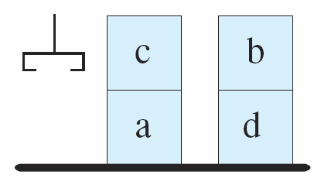
Definition: Satisfy, Model, Valid, Inconsistent
For a predicate calculus expression S and an interpretation I:
If S has a value of T under I and a particular variable assignment, then S is said to be satisfied.
If I satisfies S for all variable assignments, then I is a model of S.
on(c,a).
on(b,d).
ontable(a).
ontable(d).
clear(b).
clear(c).
hand_empty

Slide 9


Definition: Satisfy, Model, Valid, Inconsistent
For a predicate calculus expression S and an interpretation I:
If a set of expressions is not satisfiable, it is said to be inconsistent.
If S has a value T for all possible interpretations, it is said to be valid.
Can you decide a set of predicate sentences are valid?

Slide 10
Proof Procedure
The Truth Table Method
can be used to test validity for any expression not containing variables
not always possible to decide the validity of expressions containing variables
Complete Proof Procedure
can produce any expression that logically follows from a set of expressions

Slide 11
Definition: Proof Procedure
A Proof Procedure is a combination of an inference rule and an algorithm for applying that rule to a set of logical expressions to generate new sentences
Example
Resolution Inference Rule

Slide 12
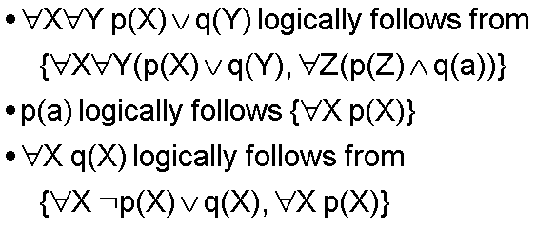
Definition: Logically Follows
A Predicate calculus expression X logically follows from a set S of predicate calculus expressions if every interpretation and variable assignment that satisfies S also satisfies X.

Slide 13
Definition: Sound and Complete
Inference rule is sound if every expression produced by the rule from S also logically follows from S.
토끼는 눈이 좋다, 토끼는 당근을 먹는다 ➔ 당근을 먹으면 눈이 좋아진다 (abduction, not sound)
Inference rule is complete if the rule can infer every expression that logically follows from S.

Slide 14

Useful Inference Rules
Modus Ponens: P and P→Q infer Q
Modus Tolens: P→Q and ¬ Q infer ¬ P
Elimination: P ∧ Q infer P and Q
Introduction: P and Q infer P ∧ Q
Merge: P ∨ Q and ¬ P ∨ Q infer Q
Chaining: P→Q and Q→R infer P→R
Universal Instantiation:

Slide 15
Modus Ponens
Modus Ponens: P and P→Q infer Q
Simple example
“if it is raining then the ground will be wet” and “it is raining”
P: “it is raining”
Q: “the ground is wet”
set of axioms: {P→Q, P}
through an application of modus ponens
Q may be added to the set of true expressions

Slide 16

Modus Ponens (2)
Example containing variables
common syllogism
“all men are mortal and Socrates is a man; therefore Socrates is mortal.”
“all men are mortal” may be represented by
“Socrates is a man” is
man(socrates).
we may substitute any value in the domain for X, because the X is universally quantified
man(socrates) → mortal(socrates).

Slide 17
Undecidability
Validity proof of full predicate calculus is undecidable
due to variable - possibly infinite
Exist a procedure to prove valid, but cannot show invalidity
semi-decidable
called resolution refutation process

Slide 18
Finding Proof
Demonstration that WFF W logically follows from set of WFF S is proof of W given S.
Overview of Proof Procedure
If W logically follows from S, then every interpretation satisfying S also satisfies W.
No interpretation can satisfy ¬W, therefore, {S, ¬W} is unsatisfiable.
Show no interpretation exist for which each of WFFs in {S, ¬W} has value T.

Slide 19
Clause Form: conjunction of disjunctions
Convenient form for match/inference process
No implication, no universal and existential quantifiers, no parenthesis, as a collection of disjunctions
Transform from WFFs to clause form
Eliminate implication sign
Reduce scope of negation sign
Standardize variables
Eliminate existential quantifier
Convert to prenex form
Put matrix in conjunctive normal form
eliminate universal quantifier
eliminate conjunctives

Slide 20



From WFFs to Clause Form
Eliminate implication sign
substitute “¬A ∨ B” for “A→B”
Reduce scope of negation sign

Slide 21

From WFFs to Clause Form (2)
Standardize variables
a variable can be uniformly replaced by another
Eliminate existential quantifier
the dependency is explicitly defined by some function
Skolemize: to replace existentially quantified variable by a Skolem function whose argument are universally quantified variables
function letter should be new

Slide 22



From WFFs to Clause Form (3)
Convert to prenex form
move all quantifiers to front
prenex form = prefix + matrix
Put matrix in conjunctive normal form
conjunctive normal form: conjunction of finite set of disjunction
replace

Slide 23
From WFFs to Clause Form (4)
Eliminate universal quantifier
all variable are assumed universally quantified
Eliminate conjunctives
set of disjunctions

Slide 24
Unification
A process for finding substitutions of terms for variables to make expressions identical
Propositional calculus
trivial
two expressions match iff they are syntactically identical
Predicate calculus
complicated
existence of variables in the expressions
requires decision process for determining the variable substitutions under which two or more expressions can be made identical

Slide 25

Unification (2)
e.g.1
man(socrates).
We need a substitution X/socrates to infer mortal(socrates).
e.g.2
p(X) and p(Y) is identical if X/Y
Logical data base must be expressed in an appropriate form
all variables should be universally quantified ⇒ allows full freedom in computing substitutions

Slide 26
Unifier
Unifier for foo(X,a,goo(Y))
1) foo(fred, a, goo(Z))
2) foo(W, a, goo(jack))
3) foo(Z, a, goo(moo(Z)))
1’) {fred/X, Z/Y}
2’) {W/X, jack/Y}
3’) {Z/X, moo(Z)/Y} Z/X: “Z is substituted for X”

Slide 27
Requirements of Unification
Variable cannot be unified with a term containing the variable
X cannot be replaced by f(X)
Composition of unification substitutions
{X / Y, W / Z}, {V / X}, {a / V, f(b) / W} are equivalent to {a / Y, f(b) / Z}
by composition, unification substitutions are combined and returned in the recursive function unify

Slide 28
Requirements of Unification (2)
Unifier should be as general as possible
if generality is lost in the solution process,
it will lessen the scope of the eventual solution or
even eliminate the possibility of a solution entirely
e.g. unifying p(X) and p(Y)
{fred/X, fred/Y}: would lessen generality of result
{Z/X, Z/Y}: more general
a unifier g of E is a MGU(most general unifier) iff for each unifier s of E, there exist another unifier s’ such that Es = Egs’
MGU is a unifier which has only necessary substitution
for {p(X, Y, b), p(X, f(b), b)}
s = {a / X, f(b) / Y}, s’ = {a / X}, g = {f(b) / Y}

Slide 29
Function Unify
function unify(E1, E2); % for simplicity list syntax used
begin
case
both E1 and E2 are constants or the empty list: %recursion stops
if E1 = E2 then return {}
else return FAIL;
E1 is a variable:
if E1 occurs in E2 then return FAIL
else return {E2/E1};
E2 is a variable:
if E2 occurs in E1 then return FAIL
else return {E1/E2}

Slide 30
Function Unify (2)
otherwise: %both E1 and E2 are lists
begin
HE1 := first element of E1;
HE2 := first element of E2;
SUBS1 := unify(HE1, HE2);
if SUBS1 = FAIL then return FAIL;
TE1 := apply(SUBS1, rest of E1);
TE2 := apply(SUBS1, rest of E2);
SUBS2 := unify(TE1, TE2);
if SUBS2 = FAIL then return FAIL;
else return composition(SUBS1, SUBS2)
end
end %end case
end

Slide 31
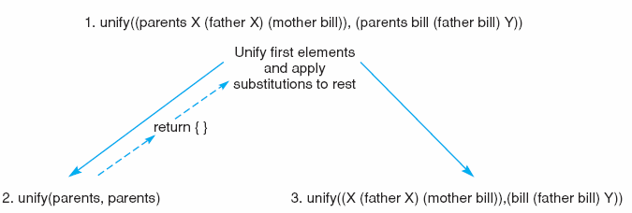
Unification Example
Figure 2.4: Initial steps in the unification of (parents X (father X) (mother bill)) and (parents bill (father bill) Y).

Slide 32
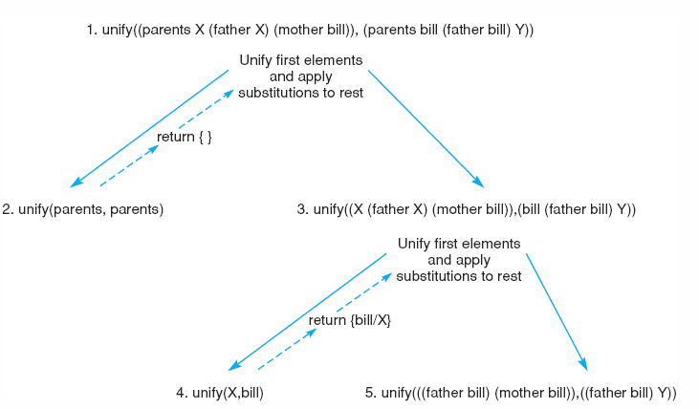
Unification Example (2)
Figure 2.5: Further steps in the unification of (parents X (father X) (mother bill)) and (parents bill (father bill) Y).

Slide 33
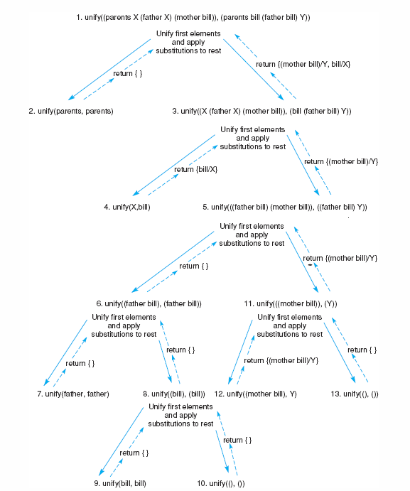
Figure 2.6: Final trace of the unification of (parents X (father X) (mother bill)) and (parents bill (father bill) Y).

Slide 34
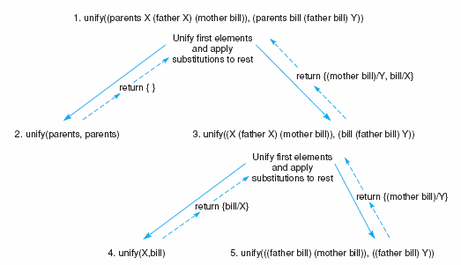
Unification Example (3)

Slide 35
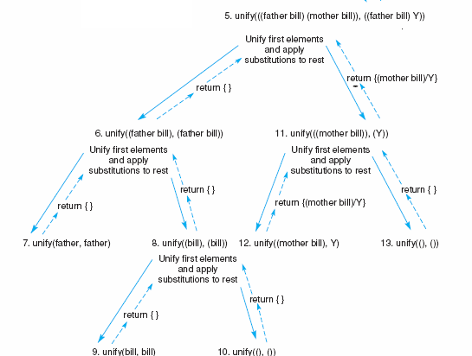
Unification Example (4)

Slide 36
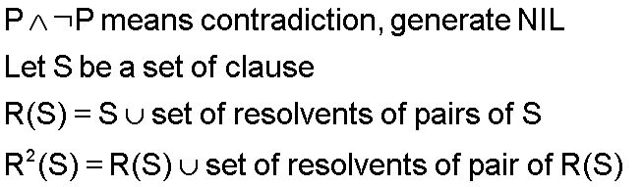
Resolution
Inferred clause is called resolvent
Resolvent search process is called resolution
Why search resolvent?

Slide 37

Resolution Refutation Proof
Given are true, prove a is true.
1) transform axioms to clause form
2) add negation of conclusion to be proved
choose any two parent clause and generate resolvent
repeat until NIL produced

Slide 38
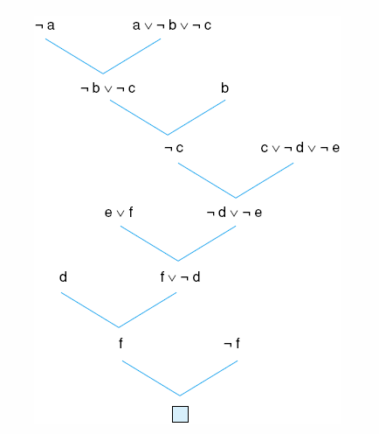
Resolution Refutation Example

Slide 39
Resolution in Predicate Calculus
Variable substitution
by MGU found by Unification Algorithm
Proof by contradiction (resolution refutation)
to prove a WFF W logically follows from S, show that S U {¬W} is unsatisfiable, i.e., no interpretation can satisfy S U {¬W}.
Meaning of NIL: contradiction produced
e.g. {p(X), ¬p(X)} ⇒ contradiction, always false, unsatisfiable

Slide 40
Predicate Calculus Resolution Example
Anyone passing his history exam and winning the lottery is happy. But
anyone who studies or is lucky can pass all his exam. John did not
study but he is lucky. Anyone who is lucky wins the lottery. Is John
happy?
Predicate sentences
Anyone passing his history exam and winning the lottery is happy.
Anyone who studies or is lucky can pass all his exam.
John did not study but he is lucky.
Anyone who is lucky wins the lottery.

Slide 41
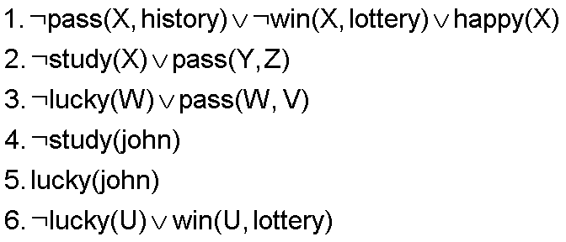

Happy Student Problem
Clause form
the negation of the conclusion
Resolution refutation graph shows a derivation of the contradiction and, consequently proves that John is happy.

Slide 42
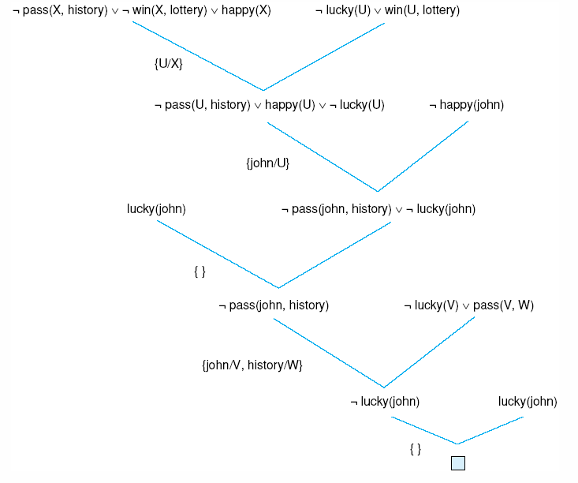
Resolution Refutation Graph

Slide 43
Exciting Life Problem
All people who are not poor and are smart are happy. Those people who read are not stupid. John can read and is wealthy. Happy people have exciting lives. Can anyone be found with an exciting life?

Slide 44
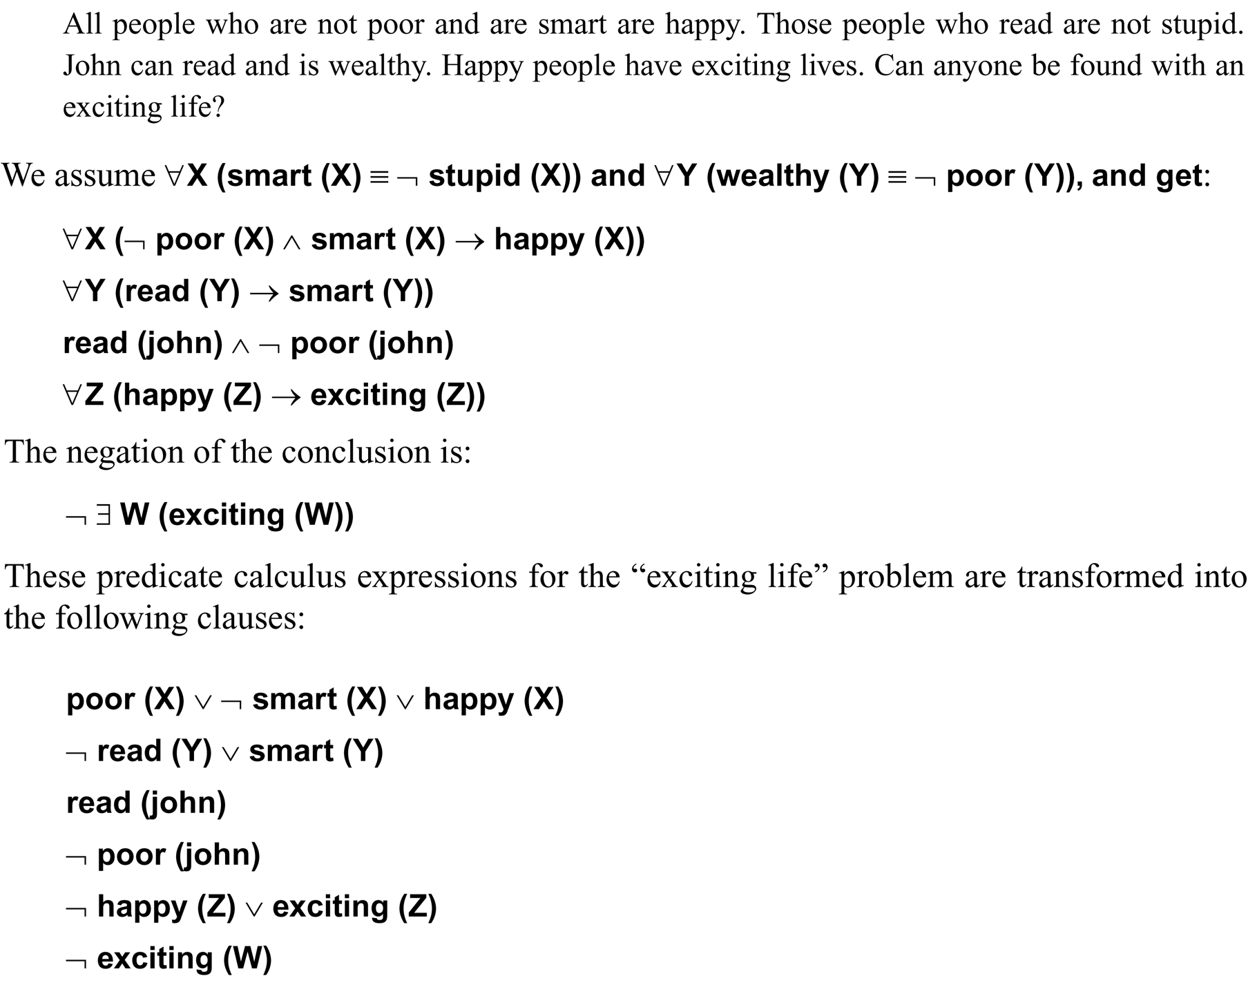

Slide 45
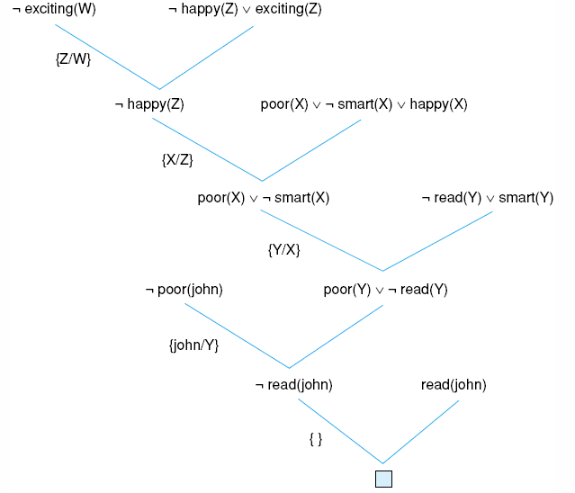
Fig 13.6 Resolution proof for the “exciting life” problem.

Slide 46
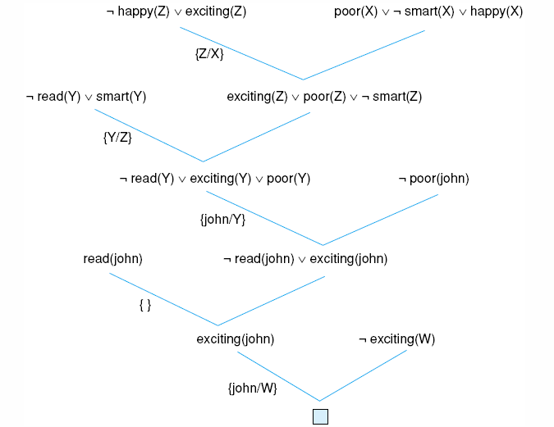
Fig 13.7 another resolution refutation for the example of Fig 13.6.

Slide 47
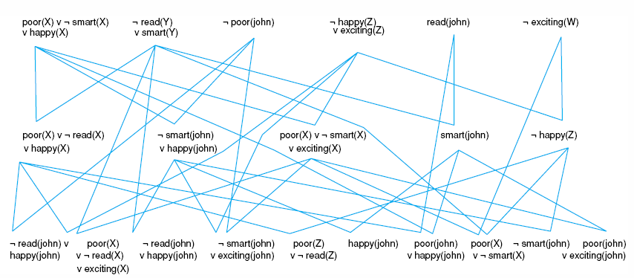
Fig 13.8 Complete state space for the “exciting life” problem generated by breadth-first search (to two levels).

Slide 48
Control of Resolution
Derivation graph
to keep track of which resolution have selected
initial nodes: clauses in the given S
new nodes: resolvents
link: from parent clauses to resolvent
Refutation tree
a subgraph of derivation graph having a root node labeled by NIL
shows a sequence of resolution that demonstrate the set S is unsatisfiable

Slide 49
Control Strategy
Control Search of a Refutation Tree in a Derivation Graph
Completeness and Efficiency
Breadth-First Search:
lower level first
complete but not efficient
Set-of-Support Strategy
at least one is either the negated goal clause or a clause produced by resolutions on the negated goals
an excellent strategy for large clause spaces
Unit-Preference Strategy
set-of-support + single literal first
Linear-Input Form Strategy
direct use of the negated goal and the original axioms
not a complete strategy

Slide 50
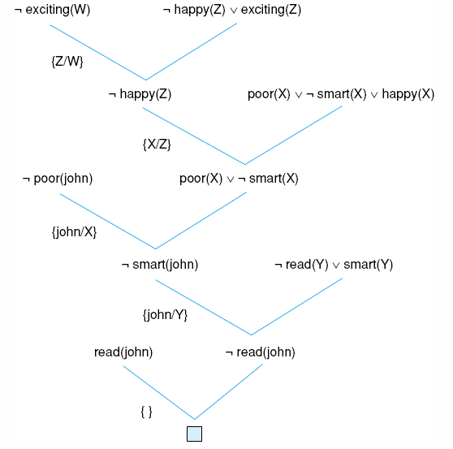
Fig 13.9 Using the unit preference strategy on the “exciting life” problem.

Slide 51
Answer Extraction
Find satisfying instances for existentially quantified variables
e.g. Fido the dog goes wherever John, his master, goes and John is at the library. Where is Fido?
Axioms:
∀X at(john, X) → at(fido, X).
at(john, library).
Theorem:
∃Z at(fido, Z).
Clauses:
¬at(john, X) ∨ at(fido, X).
at(john, library).
¬at(fido, Z) (Fido is nowhere!)
The value of existentially quantified variable is the answer

Slide 52
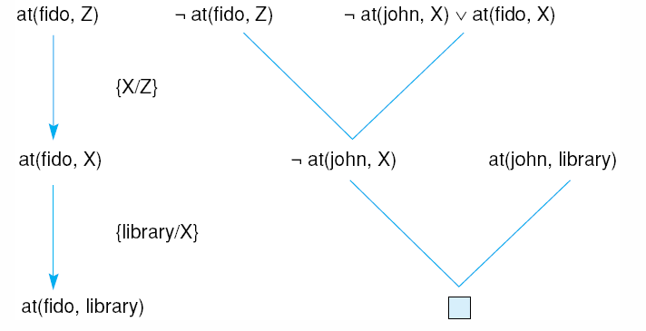
Answer Extraction (2)

Slide 53
Logic in Problem Solving
State-Space Problem Solving
define problem state by a set of predicate-calculus WFFs
state-space operator changes WFFs to another
theorem proving is used for
checking whether a state is a goal state or not
checking whether an operator is applicable

